Slide 1

Programme B.Tech
BCSE497J – Project – 1
SKIN LESION TRIAGE AND MONITORING SYSTEM WITH QUALITY GUIDED CAPTURE
Team members:
Rohit Shrivastava (23BCE0052)
Anshika Rai (23BCE0080)
Harshita Singh (23BCE0103)
Faculty guide :
Dr.Sharmila C.

Slide 2
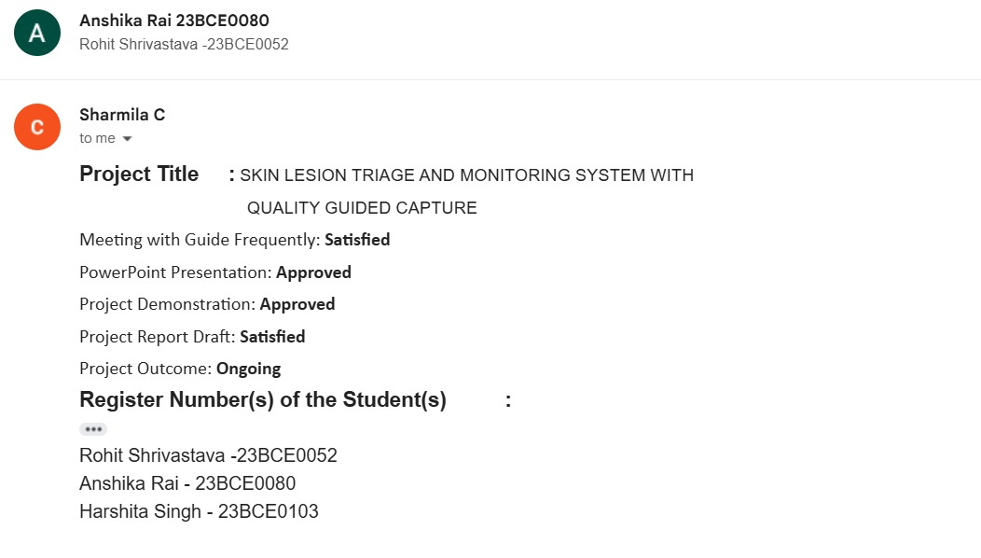
Approval Mail From Guide

Slide 3
Aim
To develop an explainable AI-powered web platform for preliminary skin lesion classification and doctor-assisted teledermatology consultation, improving accessibility, supporting early skin disease detection, and reducing wait times for dermatological care.

Slide 4
Abstract
The proposed AI Derma Assistant is a web-based platform designed to provide preliminary AI-driven skin lesion screening and improve accessibility to dermatological care
The system utilizes a ResNet18 Convolutional Neural Network (CNN) with transfer learning to classify user-uploaded skin lesion images into seven clinically relevant categories.
To improve transparency and user trust, the platform integrates Grad-CAM (Explainable AI), which generates visual heatmaps highlighting the regions responsible for the model's predictions.
A Large Language Model (LLM)-powered conversational assistant enables users to ask natural-language questions and receive easy-to-understand explanations of the AI results.
The platform incorporates a teledermatology module that forwards AI-generated reports to registered dermatologists for professional verification and consultation.
The system is intended as a triage and awareness tool, supporting healthcare professionals rather than replacing clinical diagnosis.
By integrating computer vision, Explainable AI, conversational AI, and human-in-the-loop verification, the proposed platform aims to deliver a scalable, accessible, transparent, and trustworthy solution for early-stage skin health screening.
The overall goal is to support early detection, enable timely referrals, and reduce the burden on dermatological healthcare services.

Slide 5
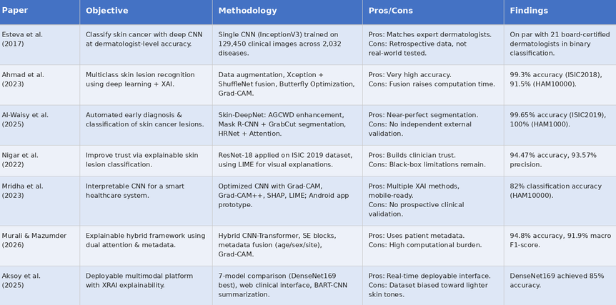
Literature Review

Slide 6
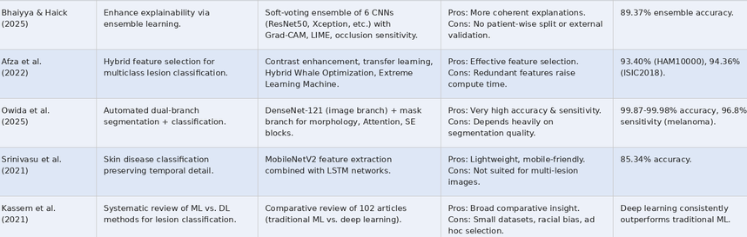
Literature Review

Slide 7
Research Gap
Gap 1: Lack of Clinical Validation for AI Explanations
LLM chatbots have been shown to translate diagnostic results into plain language, but this is validated mostly through simulated interactions, not real clinical trials
Only 16% of LLM-based chatbot studies have reached actual clinical efficacy testing; the rest remain in early technical validation
Gap 2: No Long-Term Safety or Outcome Tracking
No existing studies track patient harm, confusion, or misunderstanding caused by AI-generated explanations over time
Known risks of chatbots hallucinating false information remain unaddressed in real-world diagnostic use
Gap 3: Weak Methodological Standards
65% of chatbot health-advice studies rely on subjective evaluation instead of objective comprehension metrics
Most studies fail to disclose model configuration (temperature, prompt design), making results difficult to reproduce or verify

Slide 8
Research Gap
Gap 4: Inconsistent, Unsupervised Explanations
Chatbots like ChatGPT generate different responses to the same medical report on repeated queries, risking inconsistent patient understanding
No system currently combines image-based AI diagnosis with a dermatologist-verified, explainable conversational layer
Gap 5: Lack of External and Multi-Centre Validation
Many dermatology AI models are evaluated on single datasets or single institutional data, limiting confidence in their performance across different hospitals and patient populations.
Performance can decline when models encounter new imaging devices, clinical settings, disease distributions, or demographic groups that were not represented during training.
Gap 6: Poor Integration with Real Clinical Workflows
No existing studies track patient harm, confusion, or misunderstanding caused by AI-generated explanations over time
Known risks of chatbots hallucinating false information remain unaddressed in real-world diagnostic use

Slide 9
Research Gap
Gap 7: Accuracy Without Clinical Deployment
Deep learning models achieve dermatologist-level accuracy (82%–99%) on benchmark datasets, but a critical gap exists between benchmark performance and real-world clinical deployment and generalizability
Gap 8: "Black Box" Trust Problem
Most medical AI systems remain black boxes, causing clinicians to hesitate in trusting unvalidated model logic
While XAI methods like Grad-CAM improve transparency, zero prospective clinical trials are evaluating whether these explanations actually improve live diagnostic decisions
Gap 9: Severe Dataset Bias
92% of studies carry high risk-of-bias judgments
Near-total absence of participant ethnicity reporting, with heavy reliance on fair-skinned populations limiting generalizability across diverse skin tones

Slide 10
Objectives
1. To develop a skin lesion classification model using transfer learning (ResNet18)
Justified by Nigar et al. (2022), who applied ResNet18 on the ISIC 2019 dataset and achieved 94.47% accuracy for multiclass classification, confirming that pre-trained CNN weights are highly effective for dermatological imaging tasks
2. To integrate Grad-CAM for explainable AI-driven predictions
Justified by Mridha et al. (2023) and Zia Ur Rehman et al. (2022), who used Grad-CAM heatmaps to visually highlight the model's focal regions — significantly improving trust for both users and doctors through visual reasoning
3. To combine AI-based triage with human doctor verification via a teledermatology module
Justified by Esteva et al. (2017), who showed AI on mobile devices can extend specialist reach beyond the clinic — supporting a workflow where registered doctors review AI-generated reports for final verification and prescription

Slide 11
Primary SDG: SDG 3 – Good Health and Well-Being
Directly aligns with the project's core aim: improving early detection and access to dermatological screening, particularly for underserved and remote populations
Outcomes
Conference Paper (Scopus-indexed) — based on the classification + explainability results
Prototype / Product — the working AI Derma Assistant web application itself
Current Technology Readiness Level: TRL 4 –
The core components (ResNet18 classification model, Grad-CAM explainability, and conversational AI module) have been developed and validated together in a lab/development environment, though the system has not yet been tested with real end-users or in a live clinical setting.

Slide 12
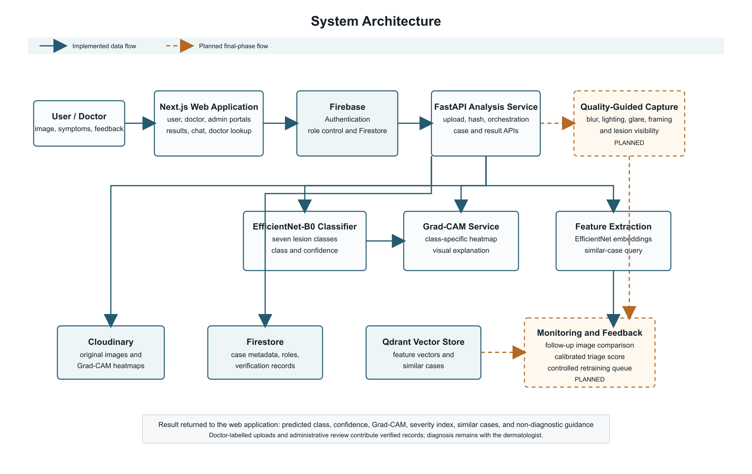
Framework/Architecture/Block Diagram

Slide 13
Functional Requirements
Secure Role-Based Access : Authenticates users and separates user, doctor, and administrator functions.
Image Submission and Storage : Collects a lesion image and questionnaire response, detects duplicate uploads, and stores case records.
Preliminary Lesion Analysis : Returns one of seven target classes with a confidence value.
Visual Explanation : Generates a Grad-CAM heatmap to show the image region that influenced the prediction.
Symptom and Similar-Case Context : Calculates the initial severity index and retrieves visually similar stored cases.
Doctor Feedback and Review : Lets verified doctors contribute labelled cases and administrators review dataset records.
Planned Safety Features : Adds quality-guided capture, follow-up comparison, and verified-feedback evaluation in the final phase.

Slide 14
Modules
Authentication and role control : Implemented
Image intake, hashing, and storage : Implemented
Classification and Grad-CAM explanation : Implemented
Questionnaire, chat, and initial severity index : Implemented
Similar-case retrieval : Implemented
Doctor upload and administrator review : Implemented
Quality-guided capture and longitudinal monitoring : Final-phase development

Slide 15
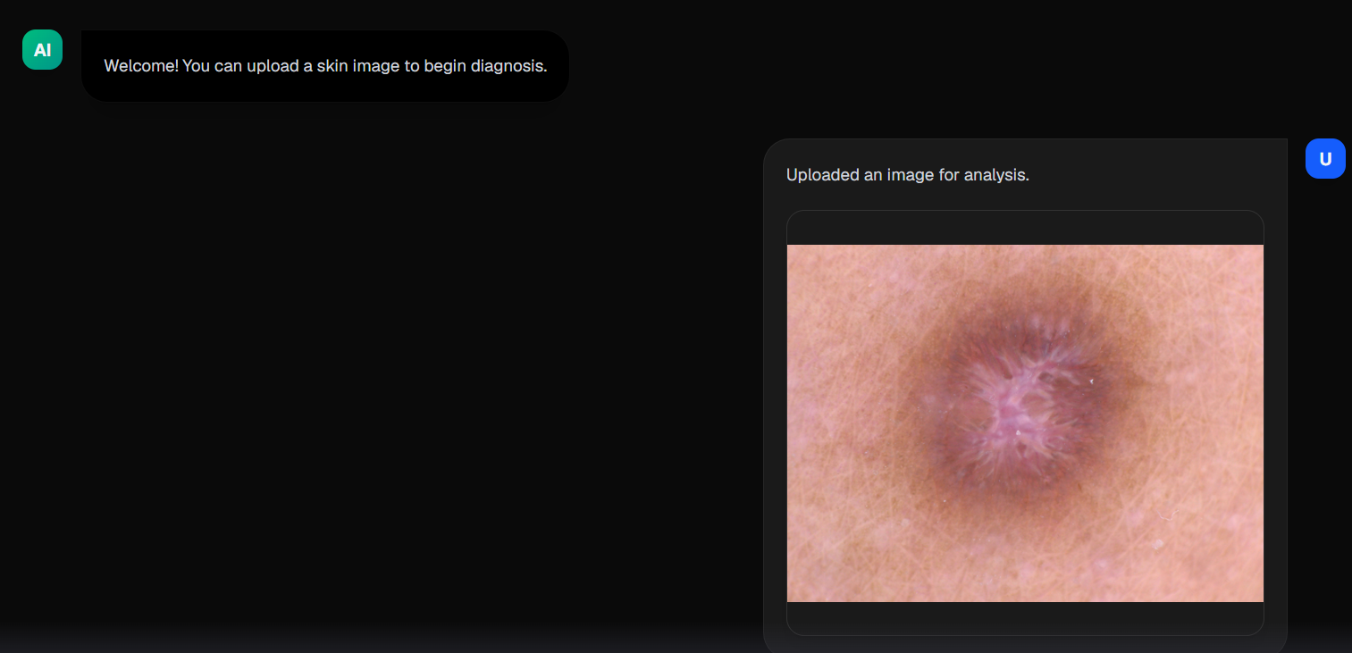
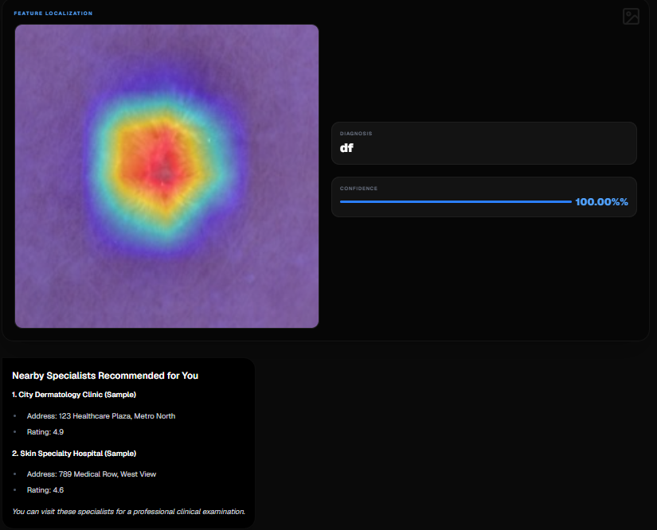
Experiments and Results

Slide 16
Conclusion
The current prototype completes an end-to-end preliminary lesion-screening workflow with secure access, image analysis, visual explanation, similar-case retrieval, symptom-aware severity support, and doctor-labelled data contribution. The final phase will add quality-guided capture, explainable confidence-aware triage, repeated-image monitoring, and a verified feedback workflow. The platform remains a decision-support prototype and requires clinical validation before any medical deployment.

Slide 17
References
[1] A. Esteva et al., "Dermatologist-level classification of skin cancer with deep neural networks," Nature, vol. 542, no. 7639, pp. 115-118, Feb. 2017.
[2] N. Ahmad et al., "A novel framework of multiclass skin lesion recognition from dermoscopic images using deep learning and explainable AI," Frontiers in Oncology, vol. 13, p. 1151257, June 2023.
[3] N. Nigar et al., "A deep learning approach based on explainable artificial intelligence for skin lesion classification," IEEE Access, vol. 10, pp. 113715-113725, 2022.
[4] K. Mridha et al., "An interpretable skin cancer classification using optimized convolutional neural network for a smart healthcare system," IEEE Access, vol. 11, pp. 41003-41018, 2023.

Slide 18
[5] P. Murali and D. H. Mazumder, "DermaScanAI an explainable hybrid deep learning framework for automated skin lesion classification using dual attention and metadata fusion," Scientific Reports, vol. 16, no. 1, p. 15130, March 2026.
[6] A. S. Al-Waisy et al., "A deep learning framework for automated early diagnosis and classification of skin cancer lesions in dermoscopy images," Scientific Reports, vol. 15, no. 1, p. 31234, Aug. 2025.
[7] S. Aksoy et al., "Web-based multimodal deep learning platform with XRAI explainability for real-time skin lesion classification and clinical decision support," Cosmetics, vol. 12, no. 5, p. 194, 2025.
[8] M. Zia Ur Rehman et al., "Classification of skin cancer lesions using explainable deep learning," Sensors, vol. 22, no. 18, p. 6915, 2022.

Slide 19
[9] F. Afza et al., "Multiclass skin lesion classification using hybrid deep features selection and extreme learning machine," Sensors, vol. 22, no. 3, p. 799, 2022.
[10] H. Owida et al., "A deep learning-based dual-branch framework for automated skin lesion segmentation and classification via dermoscopic images," Scientific Reports, vol. 15, no. 1, p. 21783, 2025.
[11] M. A. Kassem et al., "Machine learning and deep learning methods for skin lesion classification and diagnosis: a systematic review," Diagnostics, vol. 11, no. 8, p. 1390, Aug. 2021.

